Slide 1
Synthesis conditions as features

Slide 2
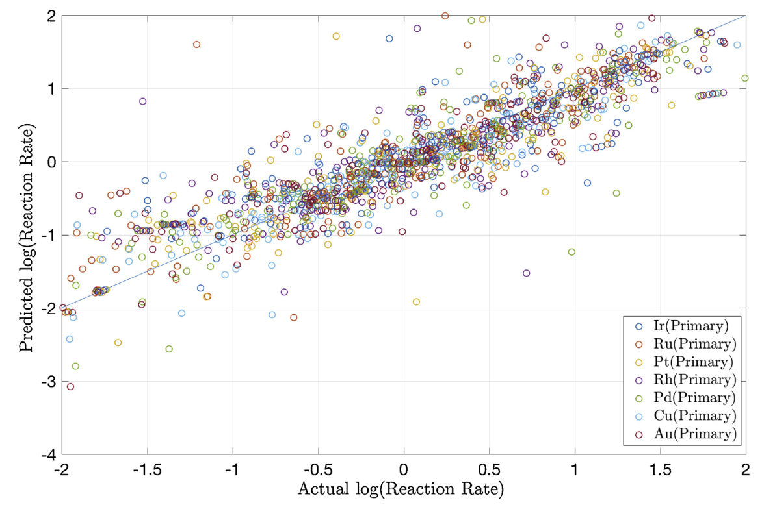
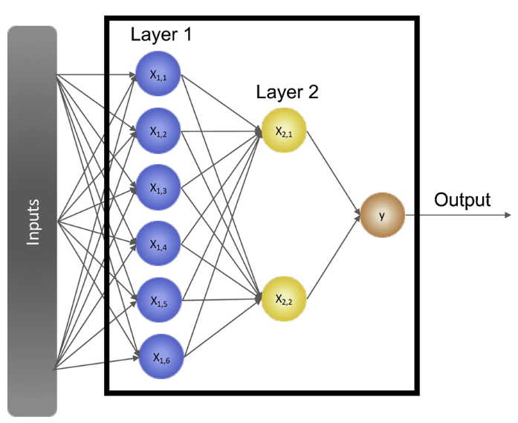
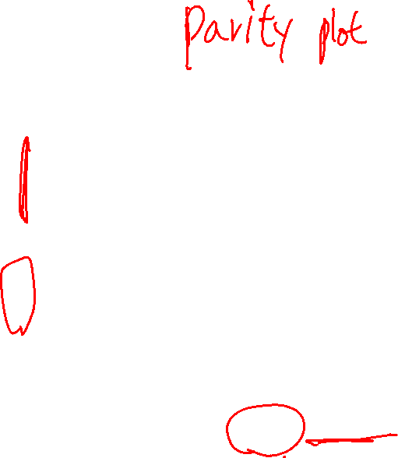
Catalyst Activity Prediction
Appl. Catal. B. Env. 2020, 263, 118257

Slide 3
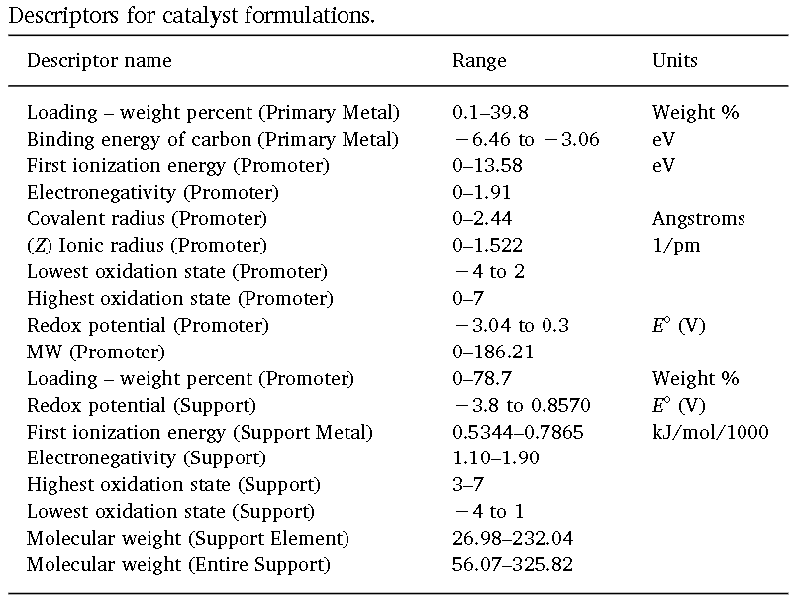
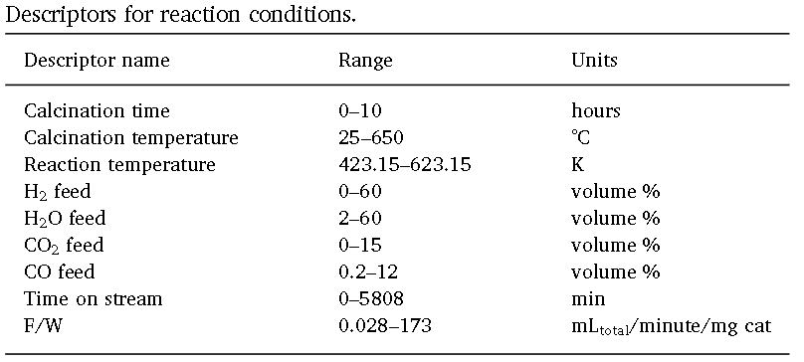
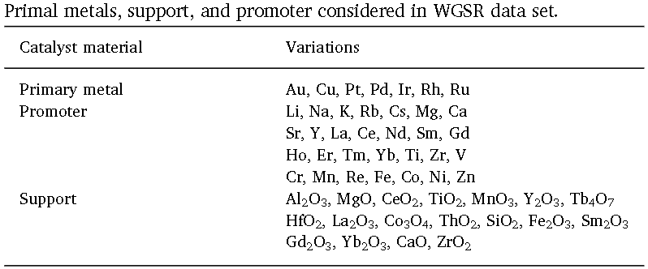
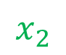
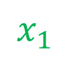
Catalyst Activity Prediction
$$x_{1}$$
$$x_{2}$$
…
Each features is normalized
Appl. Catal. B. Env. 2020, 263, 118257

Slide 4
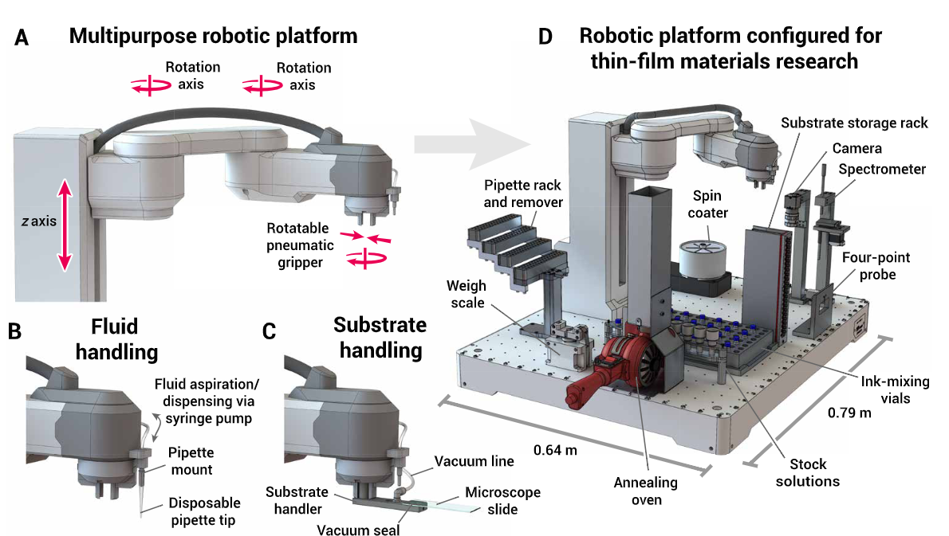
Self-driving Laboratory
Sci. Adv. 2020; 6 : eaaz8867

Slide 5
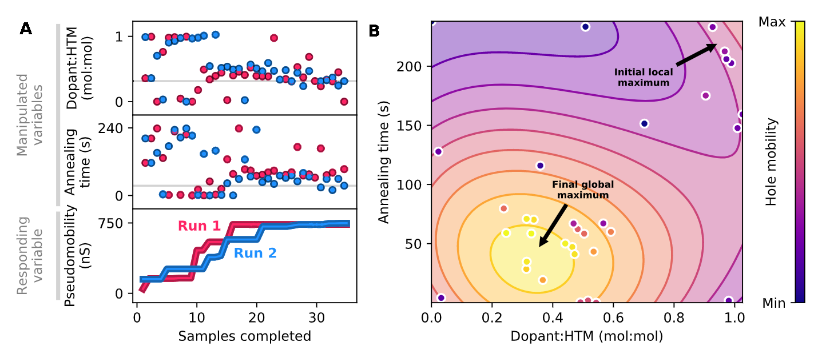
Self-driving Laboratory
Sci. Adv. 2020; 6 : eaaz8867

Slide 6
Elemental properties

Slide 7
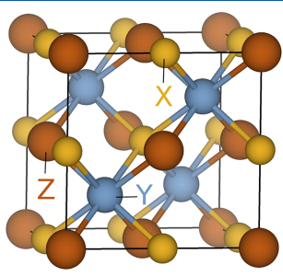
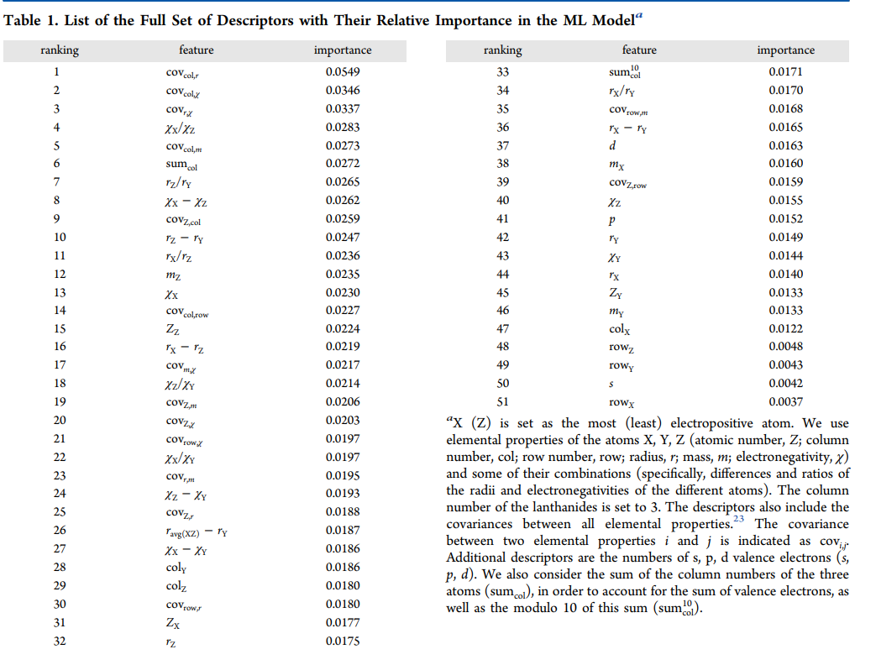
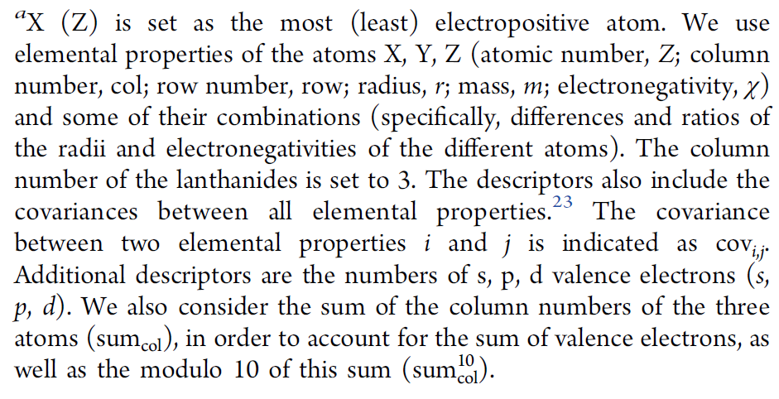
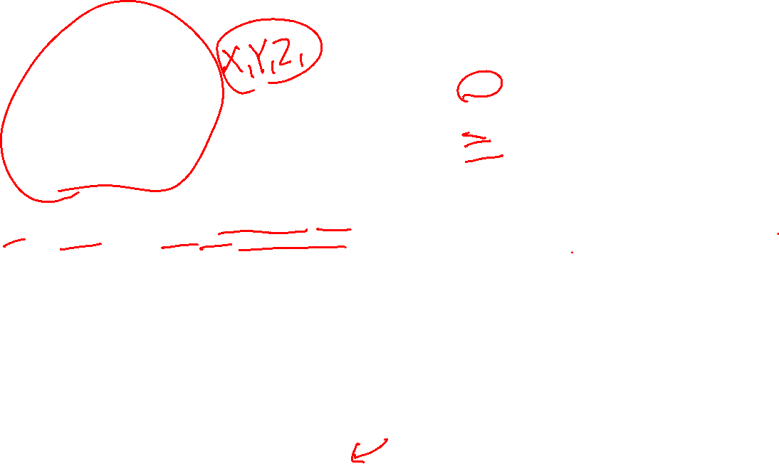
Half-Heusler Polymorph Prediction
Fixed structure: Elemental property is taken as input feature
J. Phys. Chem. B 2018, 122, 625−632

Slide 8

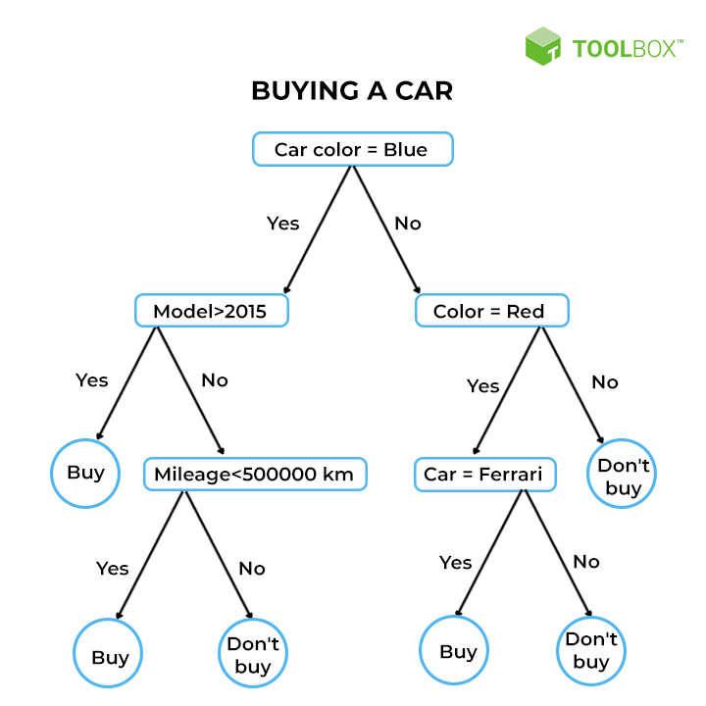
Random Forest Method

Slide 9
String representation

Slide 10
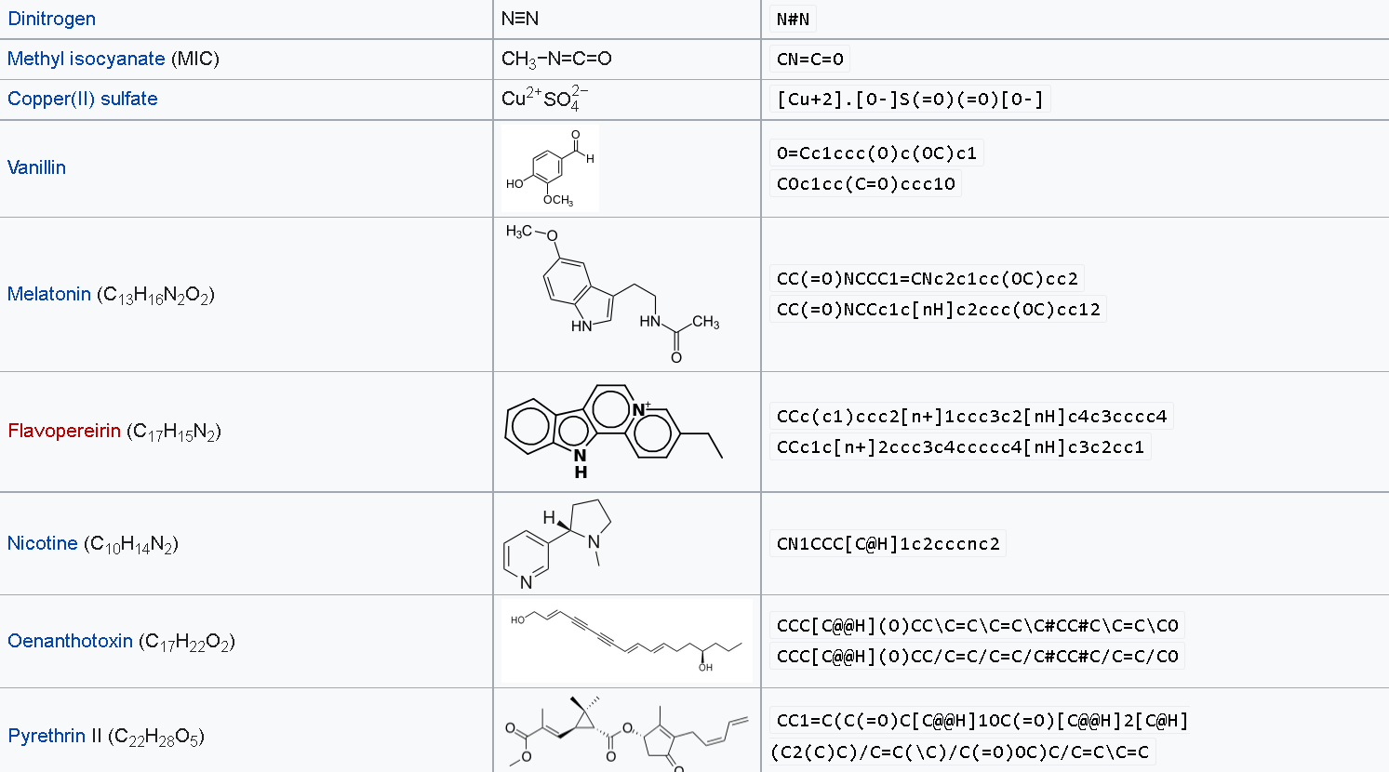
Simplified molecular-input line-entry system (SMILES)
Rules: https://www.daylight.com/dayhtml/doc/theory/theory.smiles.html

Slide 11
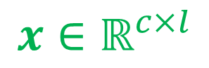
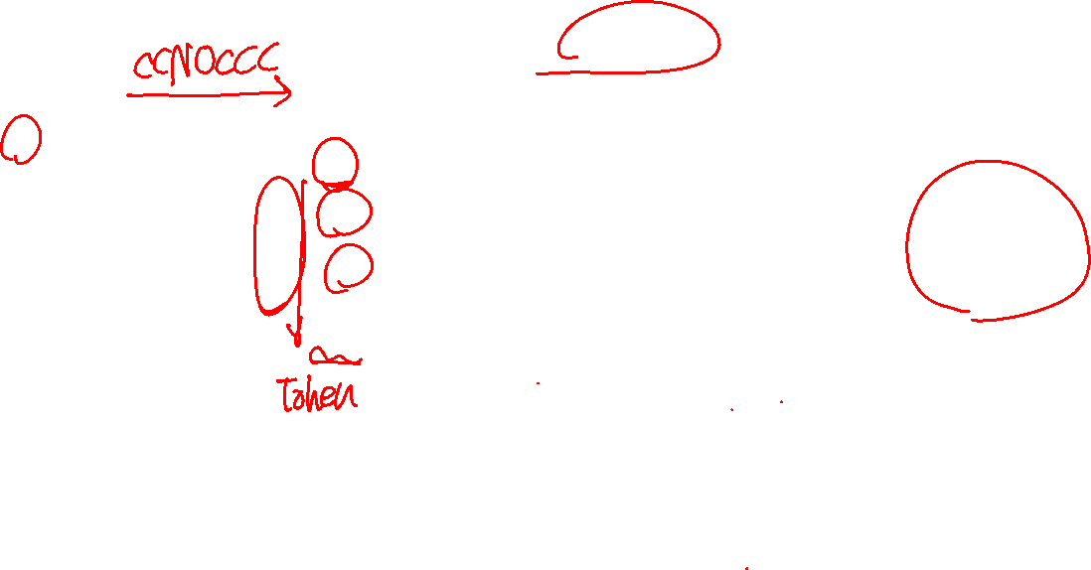
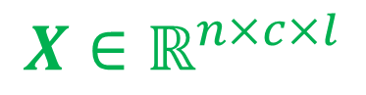
Mathematical Representation
Sequence
C
C
N
O
C
C
C
End
$$x∈ℝ^{c×l}$$
C
1
1
0
0
1
1
1
0
One hot encoding of characters
N
0
0
1
0
0
0
0
0
Character
Number of unique character
Maximum number of sequence
O
0
0
0
1
0
0
0
0
End
0
0
0
0
0
0
0
1
C
C
O
End
End
End
End
End
C
1
1
0
0
0
0
0
0
$$X∈ℝ^{n×c×l}$$
N
0
0
0
0
0
0
0
0
O
0
0
1
0
0
0
0
0
End
0
0
0
1
1
1
1
1

Slide 12
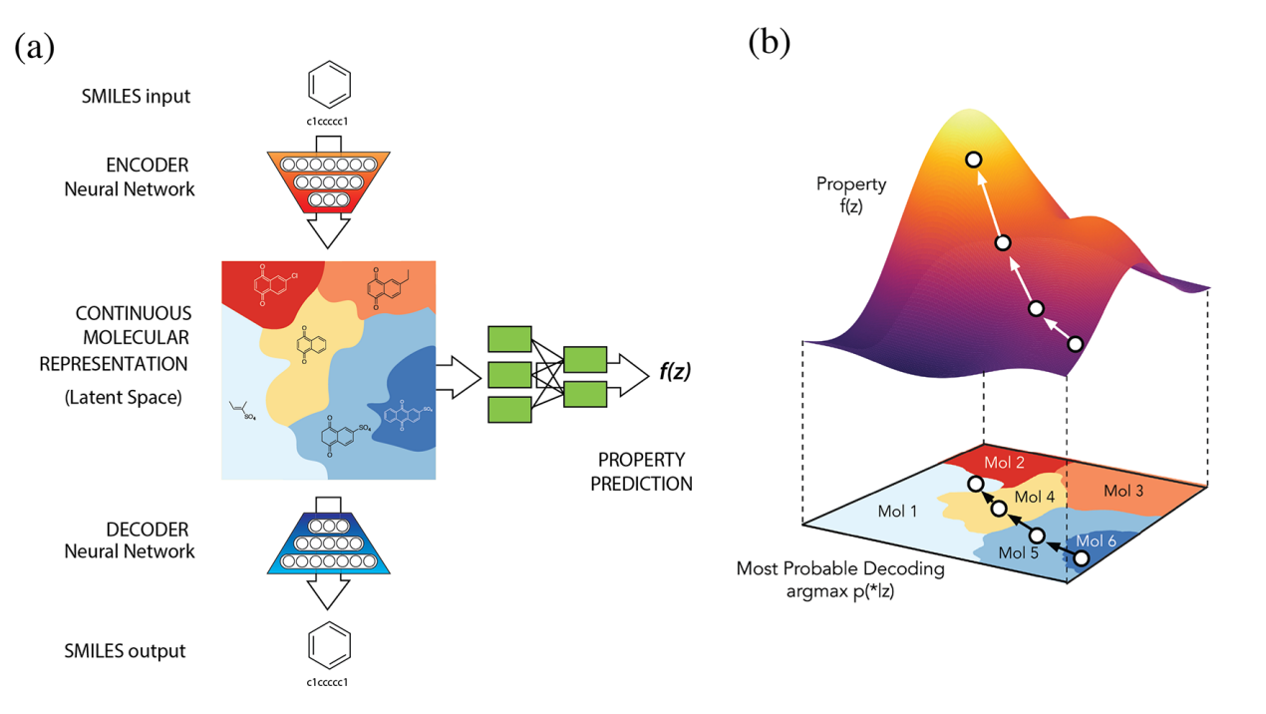
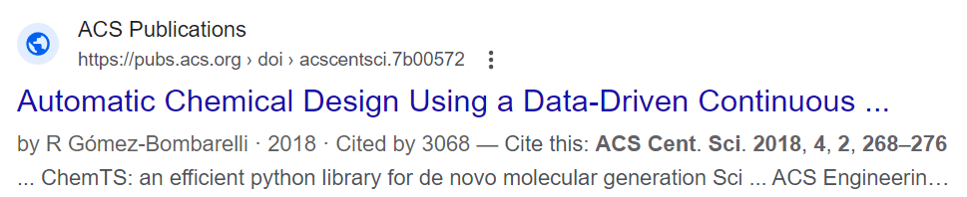
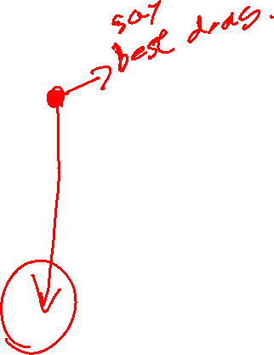
SMILES Generative Model
ACS Cent. Sci. 2018, 4, 2, 268–276

Slide 13
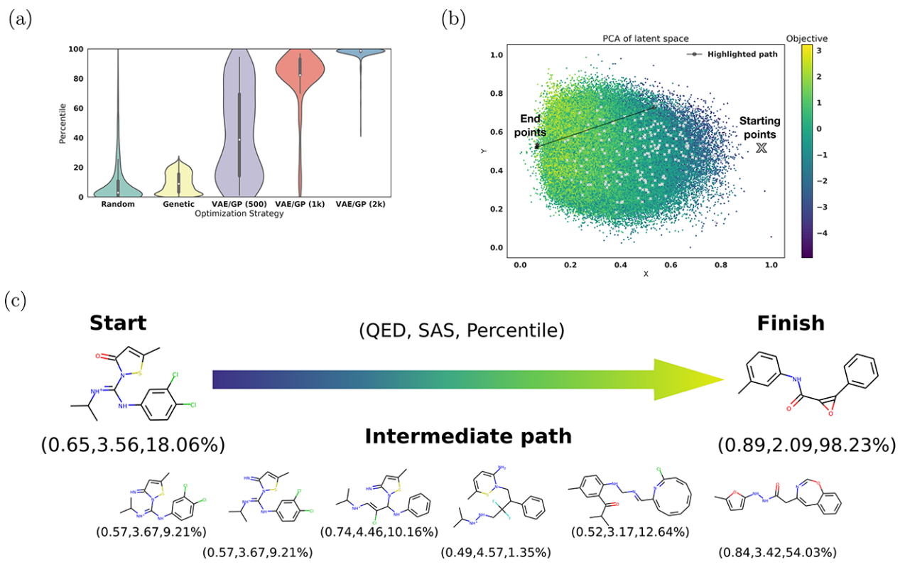
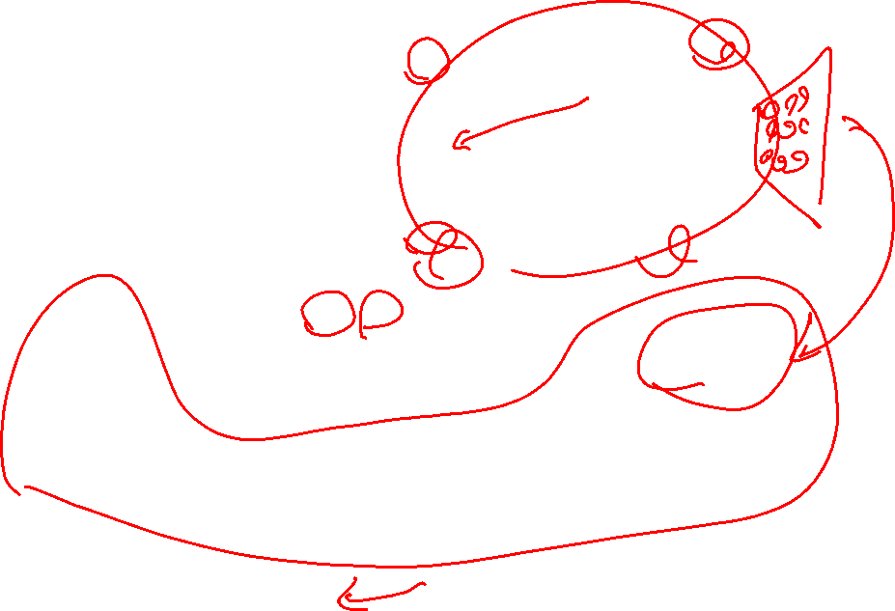
SMILES Generative Model
ACS Cent. Sci. 2018, 4, 2, 268–276

Slide 14
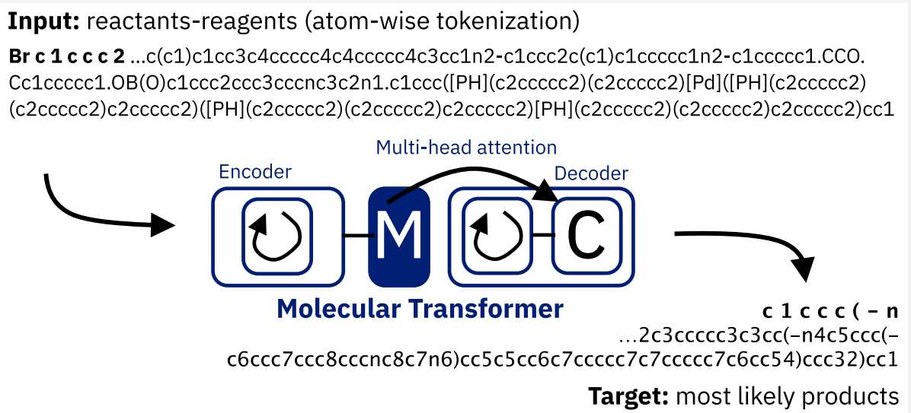
SMILES reaction prediction
ACS Cent. Sci. 2019, 5, 9, 1572–1583

Slide 15
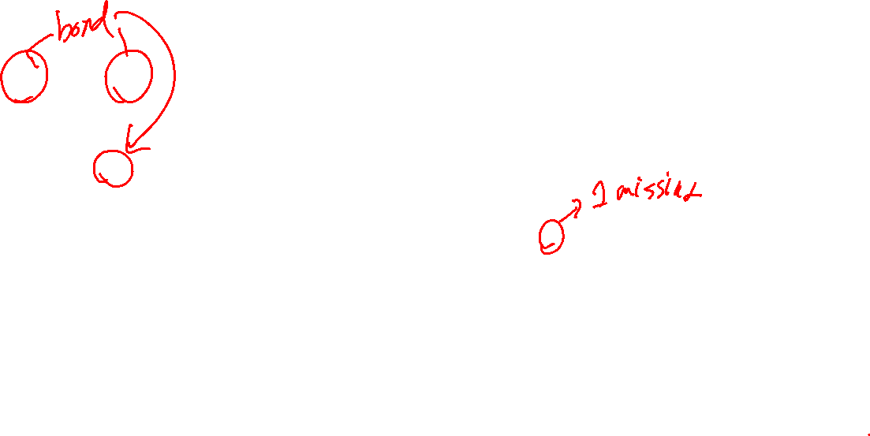
Problem with smiles
C1CCCCC1
Numbers indicate ring bonds. So there always needs to be at least 2 of the same numbers
C
1
C
1
C
C1CCCCC
C
C
C
Invalid. Ring bond is not completed.

Slide 16
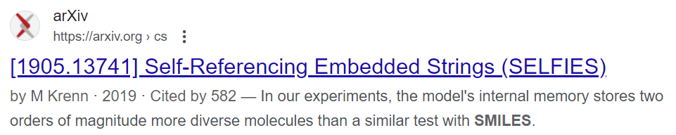
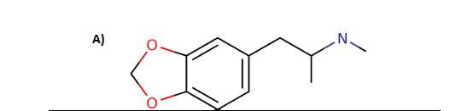
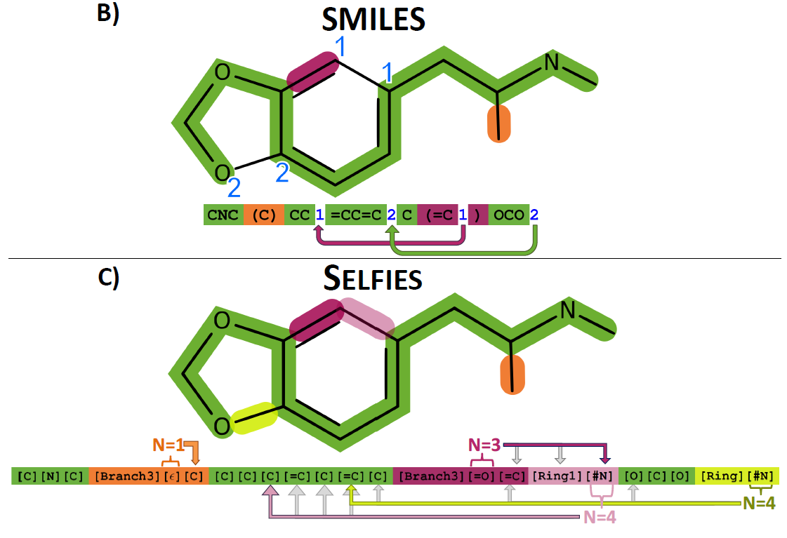

SELFIES
The atom after [ring] indicates the number of atoms it needs to go back to connect.
The atom after [branch] indicates the number of atoms it needs to go forward to connect.
String is always valid.
Machine Learning: Science and Technology 2020, 1, 045024

Slide 17
Molecular Graph theory

Slide 18
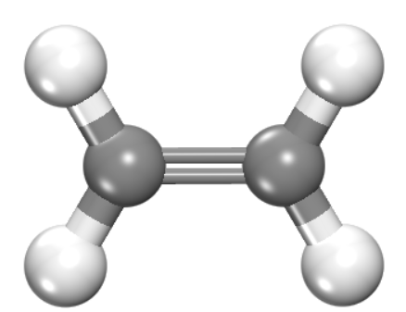
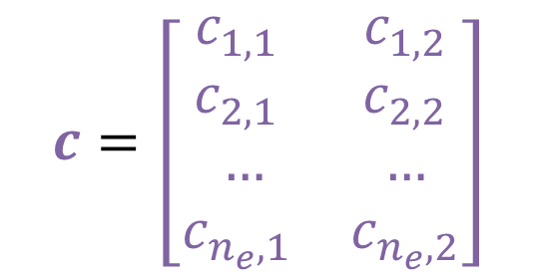
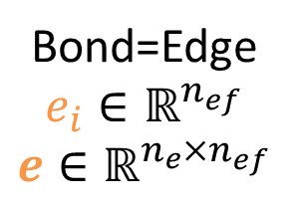
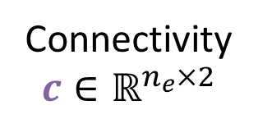
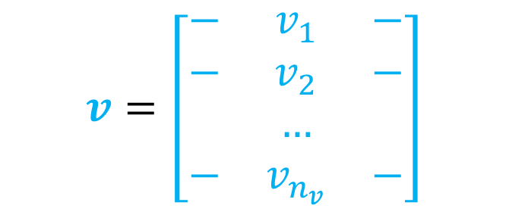
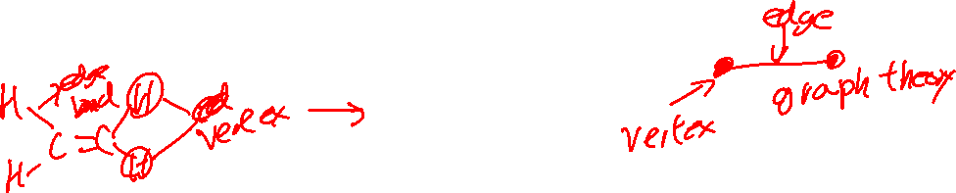
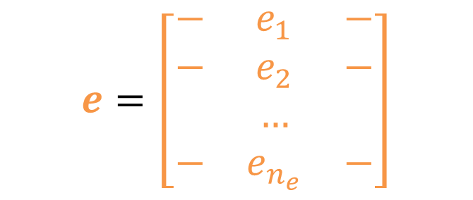
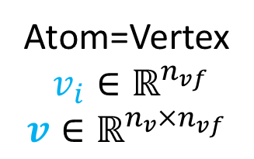
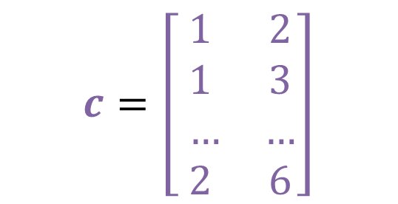
Molecular Graph Theory Representation
Atom=Vertex
$v_{i}∈ℝ^{n_{vf}}$
$$v∈ℝ^{n_{v}×n_{vf}}$$
Bond=Edge
$$e_{i}∈ℝ^{n_{ef}}$$
$$e∈ℝ^{n_{e}×n_{ef}}$$
v₃
v₅
e₂
e₄
$$v=\left[\begin{matrix}− & v_{1} & − \\ − & v_{2} & − \\ & … & \\ − & v_{n_{v}} & −\end{matrix}\right]$$
$$e=\left[\begin{matrix}− & e_{1} & − \\ − & e_{2} & − \\ & … & \\ − & e_{n_{e}} & −\end{matrix}\right]$$
v₁
e₁
v₂
e₃
e₅
v₄
v₆
$$c=\left[\begin{matrix}c_{1,1} & c_{1,2} \\ c_{2,1} & c_{2,2} \\ … & … \\ c_{n_{e},1} & c_{n_{e},2}\end{matrix}\right]$$
$$c=\left[\begin{matrix}1 & 2 \\ 1 & 3 \\ … & … \\ 2 & 6\end{matrix}\right]$$
Connectivity
$$c∈ℝ^{n_{e}×2}$$

Slide 19
Typical Features
Vertex Features
Symbol
Hybridization
Total degree
Number of H neighbor
Aromaticity
Ring size
Formal charge
Edge Features
Bond Type
Is it conjugated?
Stereochemistry
Ring
…
v₁
e₁
v₂
In some cases, H isn’t considered as vertex, as “Number of H neighbor” encodes this information already

Slide 20
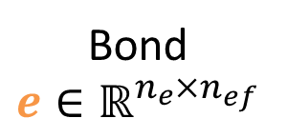
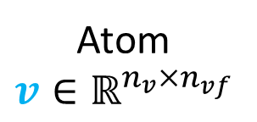
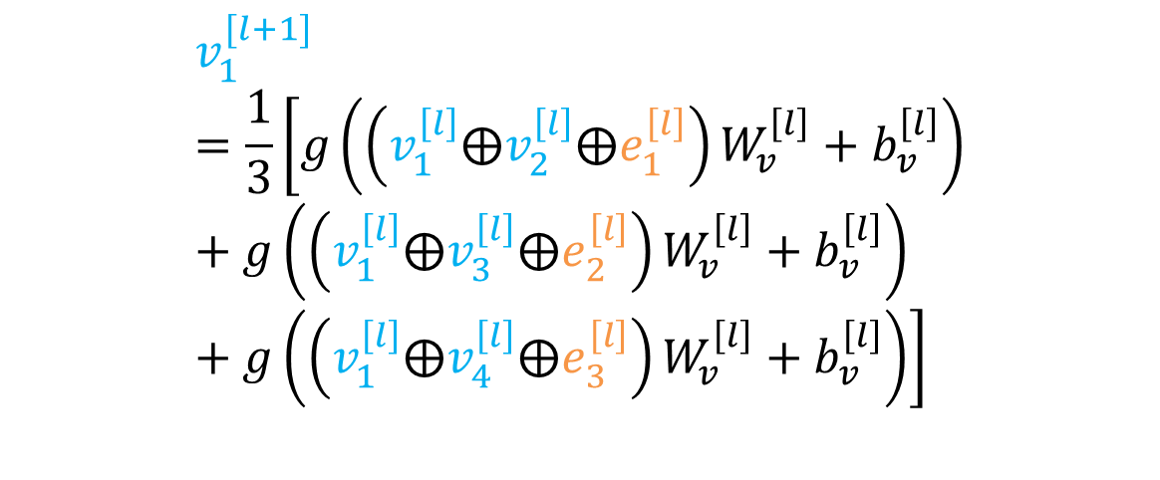
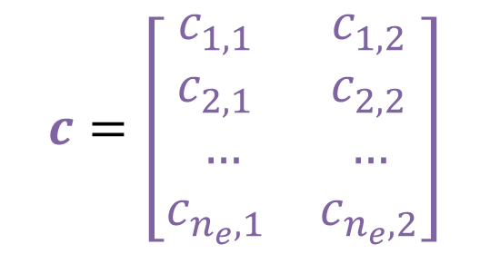


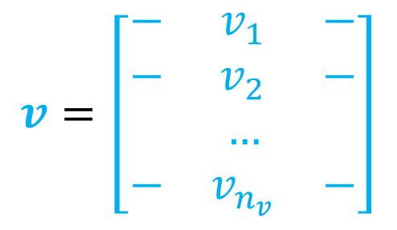
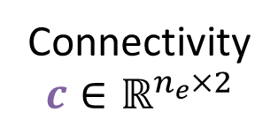

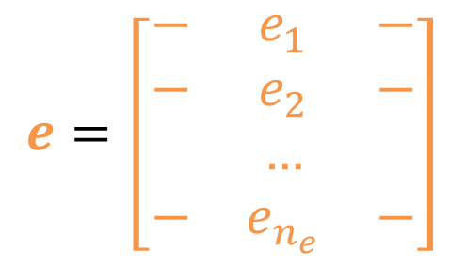
Graph Convolution
Atom
$$v∈ℝ^{n_{v}×n_{vf}}$$
Bond
$$e∈ℝ^{n_{e}×n_{ef}}$$
Connectivity
$$c∈ℝ^{n_{e}×2}$$
$$v=\left[\begin{matrix}− & v_{1} & − \\ − & v_{2} & − \\ & … & \\ − & v_{n_{v}} & −\end{matrix}\right]$$
$$e=\left[\begin{matrix}− & e_{1} & − \\ − & e_{2} & − \\ & … & \\ − & e_{n_{e}} & −\end{matrix}\right]$$
$$c=\left[\begin{matrix}c_{1,1} & c_{1,2} \\ c_{2,1} & c_{2,2} \\ … & … \\ c_{n_{e},1} & c_{n_{e},2}\end{matrix}\right]$$
Concatenation
v₃
v₅
$$v_{1}^{[l+1]}=\frac{1}{3}\left[g\left(\left(v_{1}^{\left[l\right]}⨁v_{2}^{\left[l\right]}⨁e_{1}^{\left[l\right]}\right)W_{v}^{\left[l\right]}+b_{v}^{\left[l\right]}\right)+g\left(\left(v_{1}^{\left[l\right]}⨁v_{3}^{\left[l\right]}⨁e_{2}^{\left[l\right]}\right)W_{v}^{\left[l\right]}+b_{v}^{\left[l\right]}\right)+g\left(\left(v_{1}^{\left[l\right]}⨁v_{4}^{\left[l\right]}⨁e_{3}^{\left[l\right]}\right)W_{v}^{\left[l\right]}+b_{v}^{\left[l\right]}\right)\right]$$
e₂
e₄
v₁
e₁
v₂
e₃
e₅
v₄
v₆

Slide 21
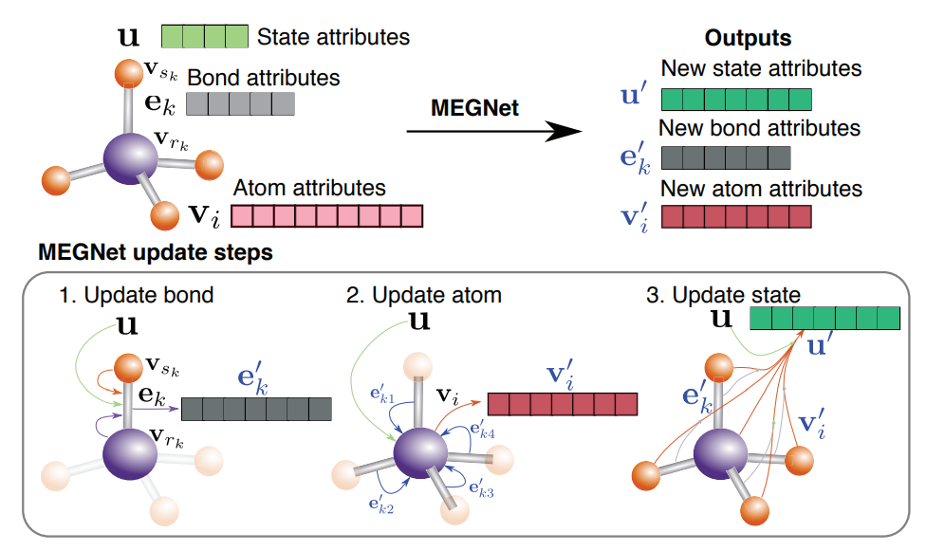
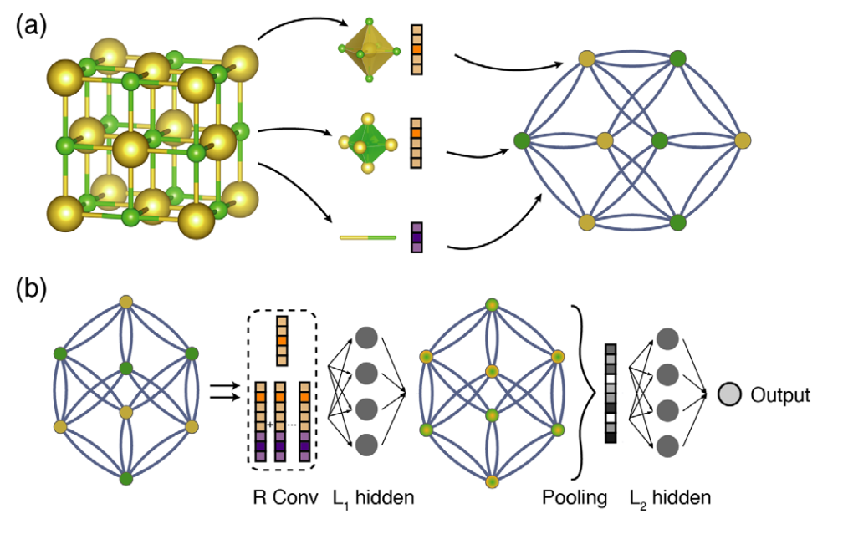
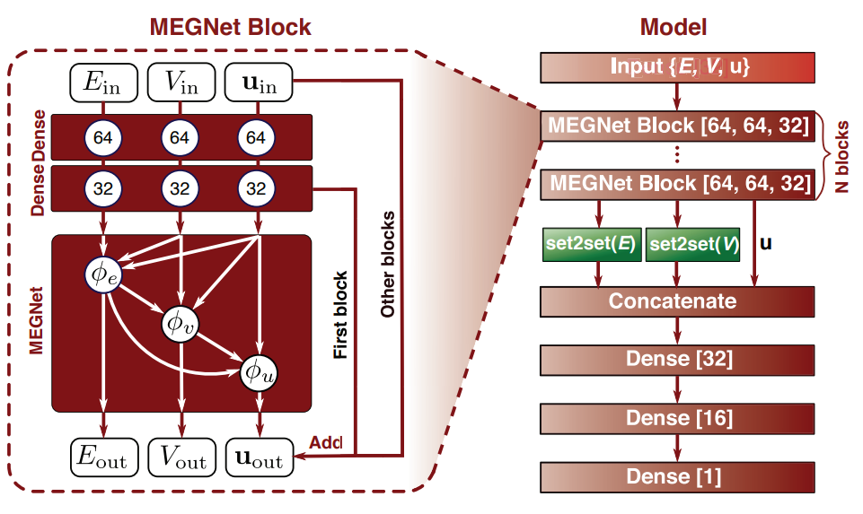
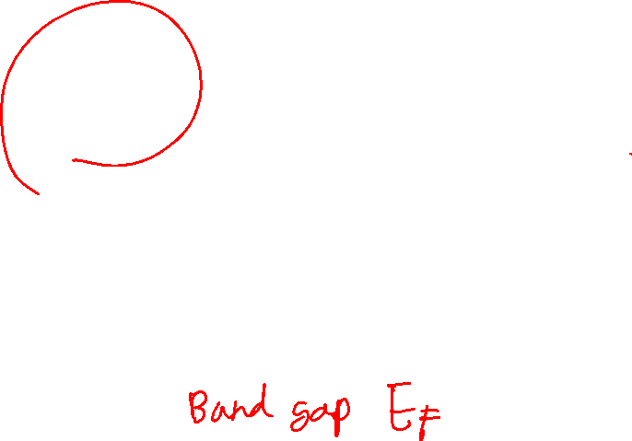
Graph Convolutional Neural Network
MEGNET
CGCNN
PHYSICAL REVIEW LETTERS 120, 145301 (2018); Chem. Mater. 2019, 31, 9, 3564–3572

Slide 22
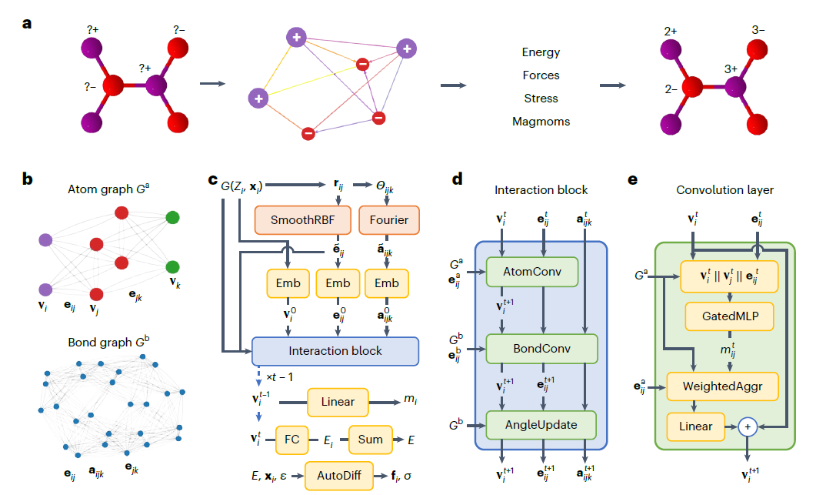



Graph Convolutional Neural Network
CHGNet
MEGNET
Nature Machine Intelligence 2023, 5, 1031; arXiv:2204.02782

Slide 23
Other representations

Slide 24


3D Voxel representation of atoms
$$X∈ℝ^{n_{x}×n_{y}×n_{z}×f}$$
Sci. Rep. 7, 16991 (2017); 1909.00949; Matter 2019, 1 (5), 1370-1384

Slide 25



3D Voxel Description
Voxel energy prediction
Generative Modeling
Sci. Rep. 7, 16991 (2017); 1909.00949; Matter 2019, 1 (5), 1370-1384

Slide 26


Fractional Coordinate Representation

Slide 27




Spectroscopy
Small 18, 2107620 (2022); Nature Commun. 2020, 11, 1513

Slide 28
Big Databases

Slide 29


Data Sets
Materials project data set
QM 9 data set
Thermodynamic energies
(e.g. for calculate reaction energy)
~130,000 data
Stability, bandgap (solar cell)
~150,000 data
https://next-gen.materialsproject.org/
http://quantum-machine.org/datasets/

Slide 30

Data Sets
The open catalyst 2020/2022
~ 600,000 data for adsorbate on surfaces
https://github.com/Open-Catalyst-Project/ocp/blob/main/DATASET.md

